Slide 6
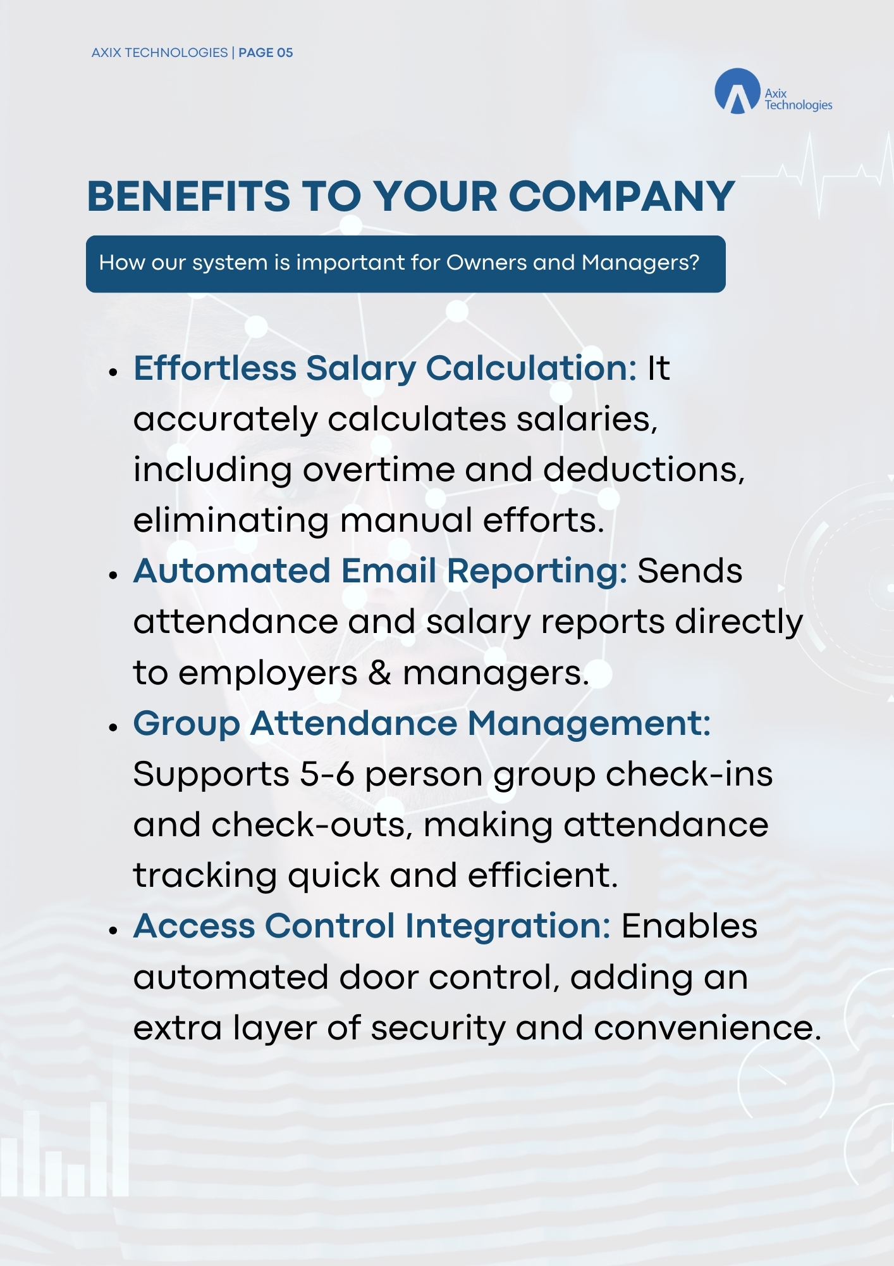

Slide 7
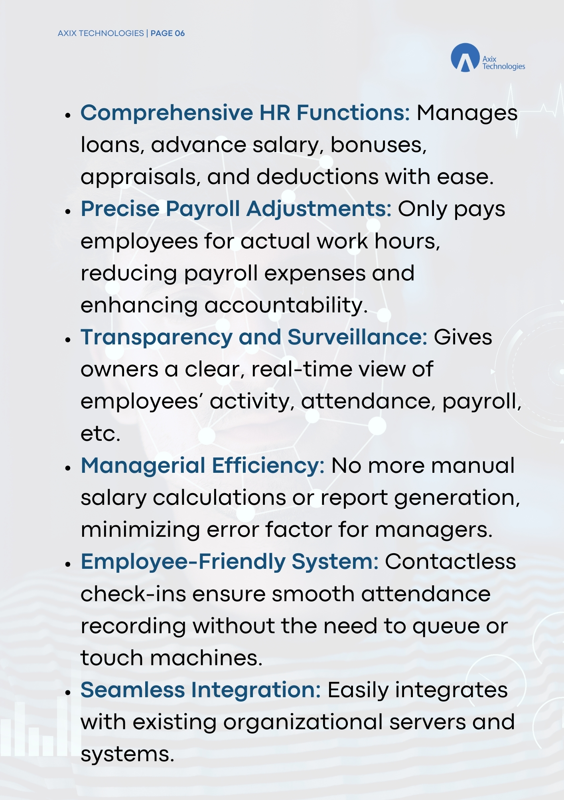

Slide 9
AXIX TECHNOLOGIES | PAGE 08

